Slide 1
231. Power of Two
class Solution {
public:
bool isPowerOfTwo(int n) {
int temp = n;
int a = 0;
if(n <= 0){
return false;
}
while(temp != 1){
if(temp%2 == 1){
a = 1;
break;
}
temp /=2;
}
if(a == 0){
return true;
}else{
return false;
}
}
};

Slide 2
258. Add Digits
int addDigits(int num) {
if (num == 0) return 0;
return 1 + (num - 1) % 9;
}
int addDigits(int num) {
while (num >= 10) {
int sum = 0;
while (num > 0) {
sum += num % 10;
num /= 10;
}
num = sum;
}
return num;
}
Time Complexity
O(1)
No loops, no recursion
Time Complexity
O(d) per iteration, where d = number of digits
Runs few times → acceptable

Slide 3
Longest Substring Without Repeating Characters
Brute Force Approach
Steps
Start with a variable maxLen = 0.
Use two loops:
  Outer loop selects starting index i.
  Inner loop selects ending index j.
For each substring from i to j, maintain a frequency array or set.
Check if the current character is already present (means repeating).
If not repeating, increase substring length and update maxLen.
If repeating, stop extending this substring and move to next i.
After checking all possible substrings, return maxLen.

Slide 4
Time Complexity
Outer loop → O(n)
Inner loop → O(n)
Checking unique characters → O(n)
Total: O(n³) (Worst case)
Space Complexity
O(n) (for checking characters)

Slide 5
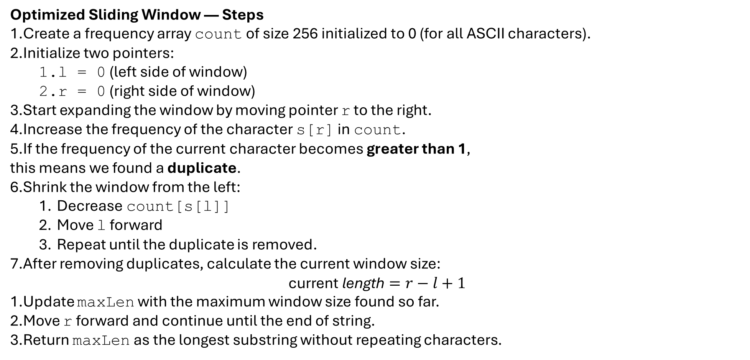
Optimized Sliding Window — Steps
Create a frequency array count of size 256 initialized to 0 (for all ASCII characters).
Initialize two pointers:
  l = 0 (left side of window)
  r = 0 (right side of window)
Start expanding the window by moving pointer r to the right.
Increase the frequency of the character s[r] in count.
If the frequency of the current character becomes greater than 1,
this means we found a duplicate.
Shrink the window from the left:
  Decrease count[s[l]]
  Move l forward
  Repeat until the duplicate is removed.
After removing duplicates, calculate the current window size:
$$\text{current} \text{length}=r−l+1$$
Update maxLen with the maximum window size found so far.
Move r forward and continue until the end of string.
Return maxLen as the longest substring without repeating characters.

Slide 6
Time Complexity
Sliding Window processes each character at most 2 times:
r moves n times
l moves n times
So: O(n)
Space Complexity
count array = O(1) fixed size 256
Final Comparison Table
Approach | Time Complexity | Space | Explanation
Brute Force | O(n³) | O(n) | Check all substrings and verify uniqueness
Sliding Window | O(n) | O(1) | Always maintain a non-repeating window

Slide 7
974. Subarray Sums Divisible by K
Brute Force Approach — Steps
Convert the array into prefix sum form.
Count how many prefix sums are divisible by k.
Check every pair of prefix sums (i, j).
If difference of the two prefix sums is divisible by k, increase count.
Return count.
Brute Force Approach (Using Prefix Sums + Checking All Pairs)
Time Complexity
Step 1: Building prefix sum → O(n)
Step 2: Counting prefix sum divisible by k → O(n)
Step 3: Checking every pair (i, j) → O(n²)
This is because there are ≈ n(n−1)/2 pairs.
Total Time Complexity = O(n²)
Space Complexity
Prefix array: O(n)
No extra significant space.
Total Space Complexity = O(n)

Slide 8
Optimal Approach — Steps (Prefix Sum + Hashmap)
Start with sum = 0 and result = 0.
Store remainder 0 with frequency 1 in the hashmap.
For every element in the array:
  Add the element to sum.
  Find remainder of sum when divided by k.
  If remainder is negative, make it positive by adding k.
  Add the frequency of this remainder to result.
  Increase the frequency of this remainder in hashmap.
Return result.
Optimal Approach — Prefix Sum + Hashmap (Remainder Frequency)
Time Complexity
You traverse the array once → O(n)
All operations (add, mod, hashmap lookup, update) = O(1) average.
Total Time Complexity = O(n)
Space Complexity
Hashmap stores at most k remainders (0 to k−1)
Space Complexity = O(k)
(If k is constant compared to n, this becomes O(1).)

Slide 9
Final Answer
Approach | Time Complexity | Space Complexity
Brute Force | O(n²) | O(n)
Optimal (Prefix + Hashmap) | O(n) | O(k)

Slide 10
Find Pair Given Difference
1. Brute-Force Approach — Steps
Start from the first element of the array.
For each element arr[i], compare it with every element after it (arr[j]).
Calculate abs(arr[j] – arr[i]).
If the result is equal to x, return true (pair found).
If all pairs are checked and no match is found, return false.
2. Two-Pointer Approach (Optimized) — Steps
Sort the array in increasing order.
Initialize two pointers: i = 0 and j = 1.
While pointer j is within the array:
  Compute the difference arr[j] – arr[i].
If the difference equals x, return true.
If the difference is greater than x, move the i pointer forward.
If the difference is less than x, move the j pointer forward.
Ensure i never becomes equal to j; if it does, increase j.
If no pair is found, return false.

Slide 11
3. Hashmap Approach (Most Efficient) — Steps
Create an empty hashmap.
Traverse the array from left to right.
For every element arr[i]:
  Check if arr[i] + x exists in the map.
  Check if arr[i] - x exists in the map.
If any of the above exists, return true (pair found).
If not found, insert the current element into the map.
If the loop ends and no valid pair appears, return false.

Slide 12
1. Brute Force — O(n²) Time, O(1) Space
For every element, you compare it with every other element → two nested loops.
Nested loops = n × n = O(n²)
No extra data structure used → O(1) space.
2. Two-Pointer Approach — O(n log n) Time, O(1) Space
First step is sorting, which takes O(n log n).
After sorting, the two pointers move only forward → O(n).
Overall dominated by sorting → O(n log n).
Only few variables used → O(1) space.
3. Hashmap Approach — O(n) Time, O(n) Space
You traverse the array once → O(n).
Each lookup and insert in hashmap takes O(1) average time.
You store elements in the hashmap → needs O(n) space.

Slide 13
Swap two numbers
Swap using temp variable (simple method)
Take two numbers a and b.
Store a in a temporary variable temp.
Assign b to a.
Assign temp to b.
Return the new values of a and b.
Swap using addition–subtraction
Add a and b and store the result in a.
Subtract the new value of a (which is a+b) with b to get original a, and store it in b.
Subtract the new value of b from the new value of a to get original b, and store it in a.
Return the swapped values.
Swap using XOR
XOR a with b and store in a.
XOR the new value of a with b and store the result in b.
XOR the new value of a with the new value of b and store in a.
Return the swapped values.

Slide 14
Addition–Subtraction Swap
Time Complexity: O(1)
Space Complexity: O(1)
Only uses constant number of arithmetic operations
No loop, no extra memory
2. XOR Swap
Time Complexity: O(1)
Space Complexity: O(1)
Only bitwise operations (XOR)
No extra variable needed
Constant work

Slide 15
Toggle bits in the given range
Step 1:- Create a mask
[1<<(r-l+1)]-1
Step 2:- Update mask
mask = mask << (l-1)
Step 3:- Find result
result = n ^mask

Slide 16
Time Complexity: O(1)
Only a few bitwise operations
No loop
Constant-time shifting and XOR
Space Complexity: O(1)
Only a few integer variables
No extra array or data structure used

Slide 17
Number is sparse or not
Approach 1: Brute Force (Check Adjacent Bits by Shifting Right One-by-One)
Logic
Take the number n.
Repeatedly check the last two bits using n & 3.
  3 in binary is 11, so n & 3 checks two adjacent bits at once.
If (n & 3) == 3, then two consecutive 1s → not sparse.
Right shift n by 1 bit and continue.
Time Complexity: O(log n)
Because you check each bit once.
Space Complexity: O(1)
Only variable used.

Slide 18
Approach 2: Optimized Using (n & (n >> 1))
Logic
This is the most efficient and most popular method.
If a number has consecutive 1s, then
n & (n >> 1)
will produce a non-zero value.
Because shifting right aligns adjacent bits, and AND reveals where both are 1.
Example:
n = 12 → 1100
n >> 1 = 0110
n & (n >> 1) = 0100 ≠ 0 → not sparse
If result == 0 → sparse
Time Complexity: O(1)
Only two operations: shift + AND.
Space Complexity: O(1)

Slide 19
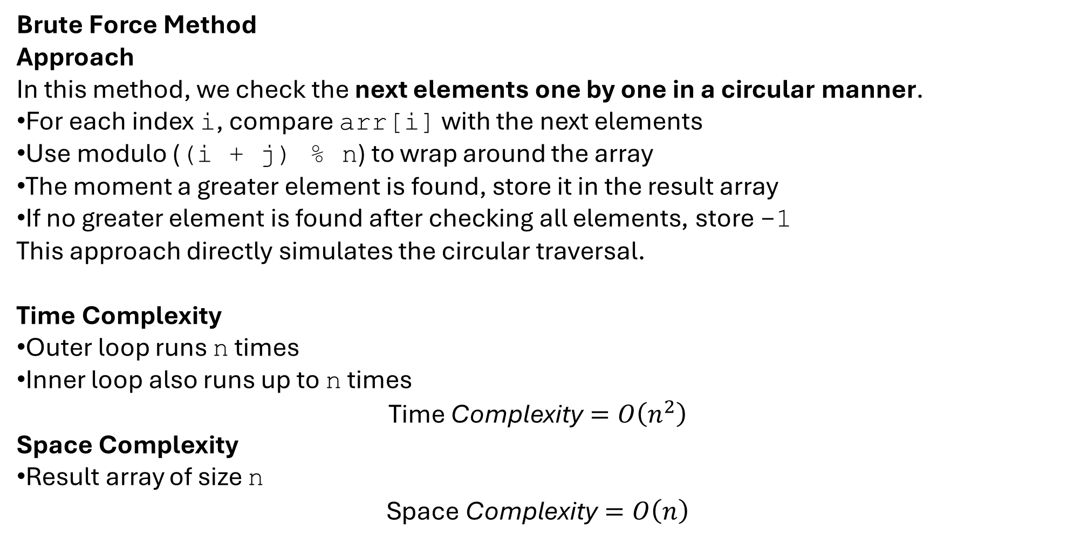
Next Greater Element in Circular Array
Brute Force Method
Approach
In this method, we check the next elements one by one in a circular manner.
For each index i, compare arr[i] with the next elements
Use modulo ((i + j) % n) to wrap around the array
The moment a greater element is found, store it in the result array
If no greater element is found after checking all elements, store -1
This approach directly simulates the circular traversal.
Time Complexity
Outer loop runs n times
Inner loop also runs up to n times
$$\text{Time} \text{Complexity}=O\left(n^{2}\right)$$
Space Complexity
Result array of size n
$$\text{Space} \text{Complexity}=O\left(n\right)$$

Slide 20
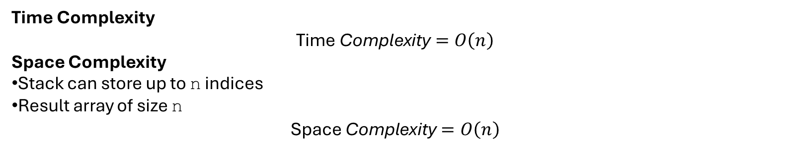
Optimal Solution (Using Stack)
Approach
This approach uses a stack to efficiently find the next greater element.
Traverse the array twice (0 to 2n−1) to simulate circular behavior
Use modulo (i % n) to access circular indices
Maintain a stack of indices whose next greater element is not found yet
When the current element is greater than the element at the stack top:
  Pop the index from the stack
  Assign the current element as its next greater element
Push indices only during the first traversal
This ensures each element is processed efficiently.
Time Complexity
$$\text{Time} \text{Complexity}=O\left(n\right)$$
Space Complexity
Stack can store up to n indices
Result array of size n
$$\text{Space} \text{Complexity}=O\left(n\right)$$
Approach | Time Complexity | Space Complexity | Efficient
Brute Force | O(n²) | O(n) | No
Stack (Optimal) | O(n) | O(n) | Yes

Slide 21
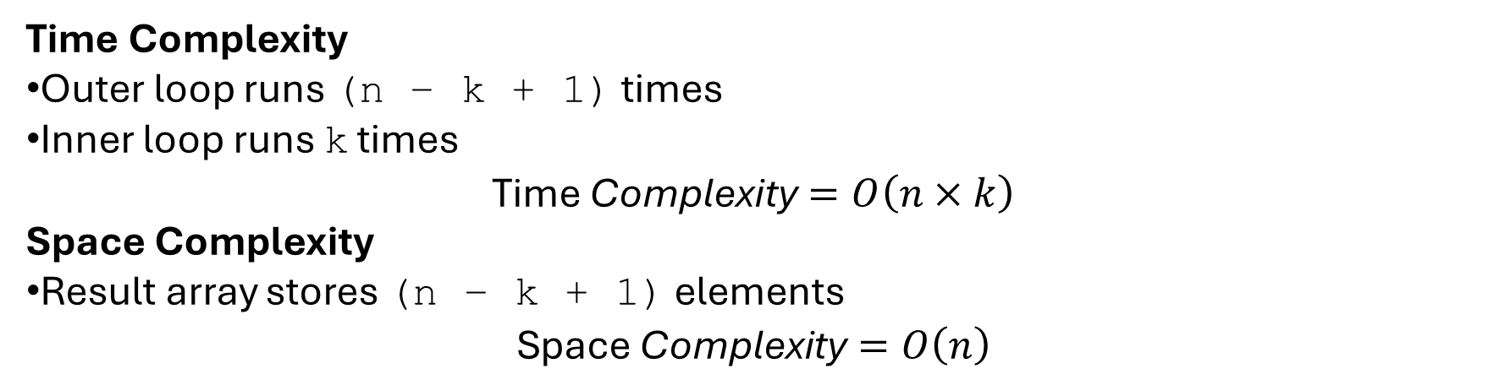
K Sized Subarray Maximum
Brute Force Method
Approach
In the brute force approach, we consider each possible subarray of size k one by one.
Start from index i = 0 to i = n − k
For each starting index i, traverse the next k elements
Find the maximum among these k elements
Store this maximum in the result array
This approach checks all elements in every window explicitly.
Time Complexity
Outer loop runs (n − k + 1) times
Inner loop runs k times
$$\text{Time} \text{Complexity}=O\left(n×k\right)$$
Space Complexity
Result array stores (n − k + 1) elements
$$\text{Space} \text{Complexity}=O\left(n\right)$$

Slide 22
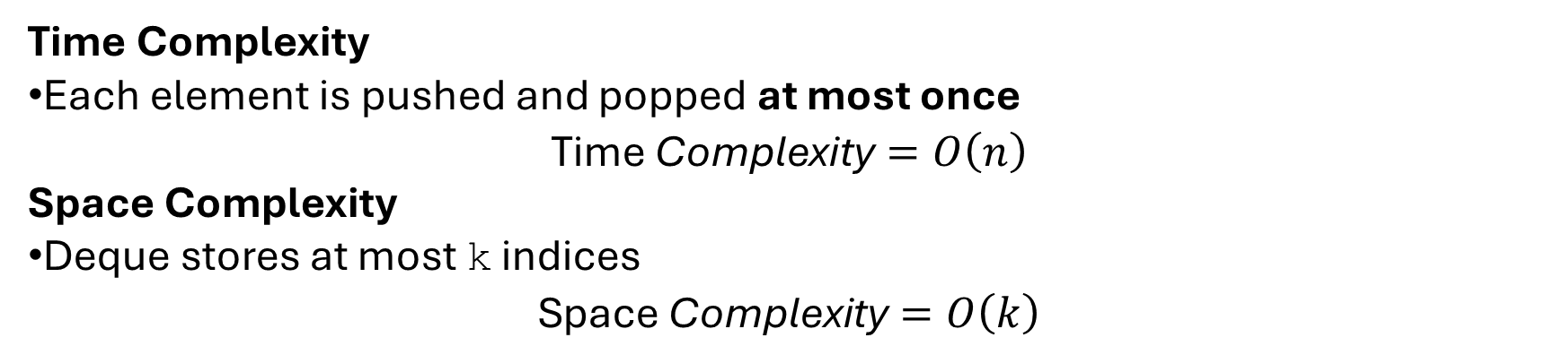
Optimal Method (Deque / Sliding Window)
Approach
This approach uses a deque (double-ended queue) to store indices of array elements.
The deque maintains elements in decreasing order of values.
Steps:
Remove indices from the front if they are outside the current window
Remove indices from the back whose values are smaller than the current element
Insert the current index at the back
The front of the deque always holds the index of the maximum element
Once the first window is formed (i ≥ k−1), add the maximum to the result
Time Complexity
Each element is pushed and popped at most once
$$\text{Time} \text{Complexity}=O\left(n\right)$$
Space Complexity
Deque stores at most k indices
$$\text{Space} \text{Complexity}=O\left(k\right)$$

Slide 23
Time Needed to Buy Tickets
Take the array tickets and the index k as input.
Initialize a variable time to 0 to store the total time taken.
Continue the process as long as the number of tickets required by the person at index k is greater than zero.
Traverse the array from the first person to the last person.
For each person, check whether the number of tickets required is greater than zero.
If yes, decrease the ticket count of that person by one and increase the value of time by one.
After reducing the ticket count, check whether the current person is the person at index k and whether their ticket count has become zero.
If both conditions are satisfied, stop the process and output the value of time.
Repeat the above steps until the required person completes buying all tickets.
Time & Space Complexity
Metric | Value
Time Complexity | O(n × max(tickets))
Space Complexity | O(1)

Slide 24
Optimal Algorithm Steps: Time Needed to Buy Tickets
Take the array tickets and the index k as input.
Initialize a variable time to 0.
Note the number of tickets required by the target person as tickets[k].
Traverse the array from index 0 to n−1.
For each person at index i, check whether i is less than or equal to k.
If i is less than or equal to k, add the minimum of tickets[i] and tickets[k] to time.
If i is greater than k, add the minimum of tickets[i] and tickets[k] − 1 to time.
Continue this process for all people in the queue.
After the traversal is complete, the value stored in time gives the total time required for the person at index k to buy all tickets.
Time and Space Complexity (Optimal Approach)
Time Complexity:
The time complexity of the optimal approach is O(n), where n is the number of people in the queue.
Space Complexity:
The space complexity is O(1)

